Slide 1
Fuzzy logic for mobile robot navigation
Ben Church

Slide 2
Content
Mobile robot navigation overview
Navigation as behavior
Crisp navigation
Behavior analysis
Implementation
Fuzzy navigation
Behavior modelling
Approaches

Slide 3
Mobile robot navigation overview

Slide 4
Navigation analysis
Consists of environment and behavior
Environment
Behavior
https://i.makeagif.com/media/1-22-2016/RbtuUx.gif
https://upload.wikimedia.org/wikipedia/commons/2/22/Spur_gears_animation.gif

Slide 5
Environment
Navigation involves variably general environments
Unknown, dynamic
Unknown, static
Known

Slide 6
Behavior objective
Continuous operation
Start to end navigation
http://thesweethome5.wpengine.netdna-cdn.com/wp-content/uploads/sites/3/2016/02/03-robot-vacuum-roomba-path-630.gif
https://i.kinja-img.com/gawker-media/image/upload/s--ttt8ckgm--/c_scale,f_auto,fl_progressive,q_80,w_800/1925wnay9ee3ugif.gif

Slide 7
Environment & Behavior
Behavior model dictated by environment
Reactive
Mechanistic
Unknown, dynamic
Unknown, static
Known

Slide 8
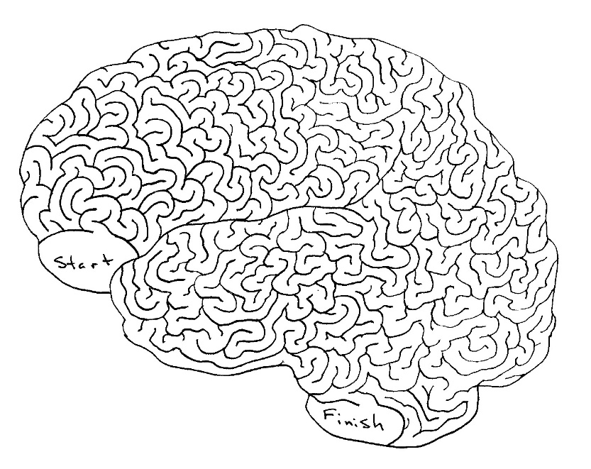
Known - Mechanistic
Robot contains environment representation
Unusable in practice
http://braininjurysociety.com/wp-content/uploads/maze.jpg

Slide 9
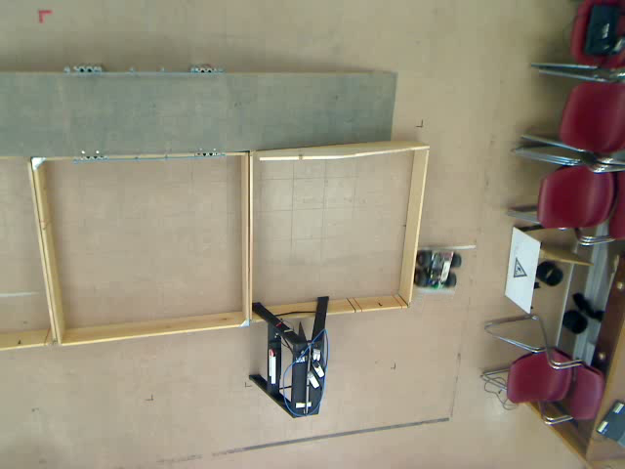
Known - Reactivity
Robot reacts to environmental uncertainty
Used for wall following behavior

Slide 10
Unknown - Reactive
Robots respond to changing environments or disturbances
http://i.imgur.com/ady1DyR.gif
http://i.imgur.com/ZiFuqF9.gif

Slide 11
Navigation as wall-following
Robot is engaged with environment
Environmental measurements guide navigation

Slide 12
General navigation
Environment
Behavior
Continuous or start-end
Function of environment
One example: wall-following

Slide 13
Crisp navigation

Slide 14
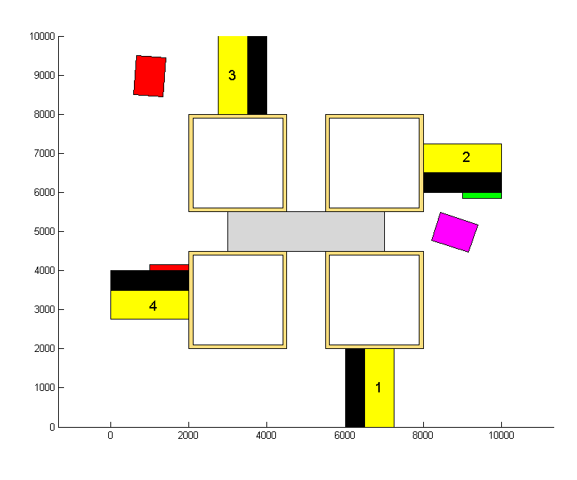
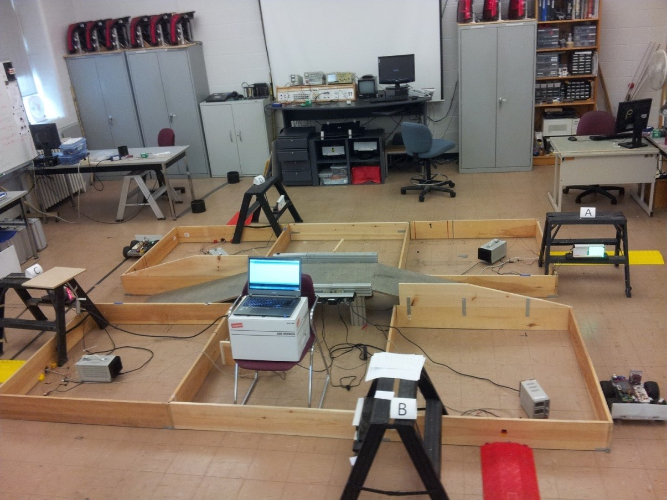
Multiple behaviors
Complex environments require behavior cases
Wall following, gap passing, turning

Slide 15
Multiple behaviors
One behavior at a time
Logical case activation condition

Slide 16
Binary behavior
Such an on-off approach to navigation suitable for known environments
Cannot count through unknown environment

Slide 17
Start-to-end navigation
Unknown environment
Behavior selection no longer a trivial problem

Slide 18
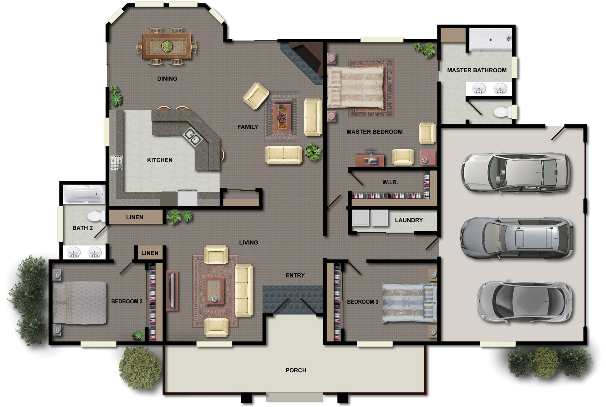
Start-to-end navigation
X

Slide 19
More behaviors
End-goal navigation
Based on known goal location and robot heading
Obstacle avoidance
Reactive

Slide 20
Crisp behavior
How is the output behavior determined?

Slide 21
Crisp behavior
Can cause sub-optimal or counter-productive path choice

